Slide 1
Letter of recommendation by Muhammad kamil khan hoorish ahmad naveed ahmad

Slide 2
What is a Letter of Recommendation?
A formal document that provides insight into an individual's qualifications and achievements.
It serves as a testament to their abilities and work ethics, offering a detailed evaluation of their strengths, skills, and contributions.
A recommendation letter is a formal letter written by a teacher, employer, or mentor to support someone’s skills, achievements, and character. It helps the reader decide if the person is a good fit for a job, university, or internship.

Slide 3
PURPOSE OF LETTER OF RECOMMENDATION?
Admissions
Job Applications
Scholarships and Internships

Slide 4
Importance:
Validates an applicant’s skills and work ethics.
Enhances the credibility of applications for jobs, scholarships, and academic programs.
Provides a personal perspective on the candidate’s abilities and potential.

Slide 5
Structure of letter of recommendation
Salutation: the part where the letter is addressed to a specific person or an unknown person.
Introduction: Clearly state the purpose of the letter, your relationship with the applicant, the duration of your acquaintance, and your credibility in providing the recommendation.

Slide 6
Structure of letter of recommendation
Applicant’s Skills and Strengths: Emphasize the applicant's strengths relevant to the application with specific examples of achievements. Highlight skills like leadership, teamwork, communication, problem-solving, technical excellence, and dedication.
Relevance to Position/Program:
Describe why the applicant is well-suited for the opportunity by aligning their skills with job requirements or emphasizing their academic performance and research potential for university applications.

Slide 7
Structure of letter of recommendation
Summary Strong Recommendation: Express your recommendation with confidence using phrases such as “I wholeheartedly recommend…,” “I strongly endorse…,” or “I have no reservations in recommending….
Conclusion – Offer for Further Contact:
Invite further inquiries by offering additional details if needed. Provide your contact information (email/phone) and conclude with a courteous closing statement.

Slide 8
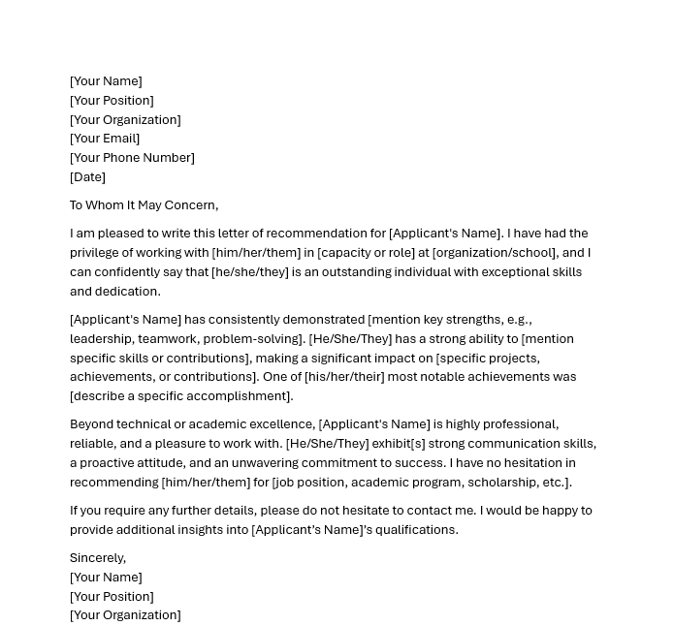

Slide 9
Thank you

